Slide 1
Object Oriented Programming
Objects, Inheritance, Encapsulation
Java
FRC Java
ArmSystem Example
Notes:
Have browser with references open
Preferably with robot on
Provide background on the first two years of Java and issues

Slide 2
Bigger Object 27
Object 1
Parameter 1
Parameter 2
Function A
Function B
Function 27.A
Function 27.B
Function 27.C
Function 27.D
Function 27.E
Function 27.F
Object 2
Parameter 1
Function C
Object 3A
Parameter 1
Object 3
Function D
Notes:
Starts with bottom level objects
Objects are basic unit
Parameters are inputs to help define an object or for a method to use in performing its function
Functions are processes (jave methods) for the class/object
Object 3A extends object3 – can be a specific instatiation or can add extension (new methods)
A class is a blueprint or generic object with standard functions defined as methods
An object is an instance of the class (blueprint)
Create an object by “instantiating” a class.
Multiple objects can be combined to make an object with a broader definition
Encapsulation – keep the inner workings of the class hidden.
expose methods
Example – big system designer specs a subsystem and puts out for bid. They spec the functionality, not how it works internally.
In FRC the best examples are speed controllers
We can do it to – allow build to come up with multiple hardware solutions as long as the functions are covered (public methods are the same)
For a test-bed, this can include “null” functions where the subsystem isn’t physically available.

Slide 3
Talon
Port
Inverted
Speed Controller
set(speed)
Digital Input (Limit Switch)
Port
get()
Sensor
Port
get()
Notes:
Speed Controller is an INTERFACE standard to all specific (make and model) motor controllers
Port is a required input so our code has the address of the controller
PWM –wired port
CAN – defined internally via web console
Set is a common method to send a “speed” value between -1 and 1 (zero is off) to the controller
The controller uses the speed range to send bus voltage (-12 to +12) to the motor
Digital Input can be any on/off one/zero input. Limit switches (a spring loaded switch that has to be held to activate) are a common use.
Be aware there are NO and NC switches, and “open” is considered “true” by RoboRIO circuitry
Sensors can be digital (0/1) or analog (0-1023 on RoboRIO)

Slide 4
Linear Actuator
Talon Speed Controller
move(speed)
moveUp()
moveDown()
isTop()
isBottom()
Top Limit Switch
Bottom Limit Switch
Notes:
This specific implementation
Theoretical – not the actual code – but a possible exercise
Would be very appropriate if there were two actuators for the arm
Functions – methods
encapsulation of the requirements of this implementation are buried inside the class
motor direction
NO vs NC switches
Direction of the motor at the time it hits a limit switch
This OO convention allows easier changes to a class, or different classes
e.g. a designer can specify standard methods (functions) in a request for bids
each bidder can build their internals for an object very differently, as long as the external functions produce the required result

Slide 5
ArmSystem
PIDController
Linear Actuator
moveArm(speed)
moveArmUp()
moveArmDown()
moveArmTop()
moveArmBottom()
moveArmHome()
moveArmOffHome()
saveHomeSetpoint()
setArmSetpoint(ix)
moveArmSetpoint()
isOnTarget()
isTop()
isBottom()
isHome()
initArmPID()
Etc.
Analog Potentiometer
Home Limit Switch
Notes:
The entire ArmSystem combines
One (or more) linear actuators to meet the required lift capacity
An analog potentiometer (or encoder) to measure arm position
A “home” limit switch to set a standard baseline position
PID control implementation to be covered in more detail later

Slide 6
FRC “Shell”
Robot
OI
Subsystems
Initialization
set things up
Autonomous
schedule commands
TeleOp
schedule commands
RobotMap
ArmSystem
Commands
Joystick Arm
upSetpointTable
enableSetpoint
etc
Notes:
WARNING
The logical structure of the ArmSystem project
The java “project has several “packages” or groupings of code members
these are physically paths/folders in the workspace
each “class” shown in Eclipse is a file
a physical class can contain multiple class definitions – this can be an extensive subject on its own out of scope right now
OI, RobotMap, and Robot are grouped in the same package for FRC convention
Commands are in another package
seen from another team was adding packages to group commands by the subsystem they work with (e.g. all Arm together, all Drive together, etc.)
Subsystems are in a package
Classes are the distinct blueprints for each object
RobotBuilder as a tool is something we’ve used the last two seasons to kick-start code
The wpilib extensions to Eclipse provide templates under the “new” for commands, command groups, subsystems, etc. for specific FRC class types
Code generators have their limits, and RobotBuilder does create confusion for a java novice by using the same names for objects and classes – not necessary a bad thing unless the class is generic

Slide 7
Java Basic
Tutorial
http://docs.oracle.com/javase/tutorial/
http://docs.oracle.com/javase/tutorial/java/concepts/index.html
Java Doc
http://docs.oracle.com/javase/8/docs/api/index.html
FRC Java
https://wpilib.screenstepslive.com/s/4485/m/13809
RobotBuilder
https://wpilib.screenstepslive.com/s/4485/m/26402
WPILib
http://first.wpi.edu/FRC/roborio/release/docs/java/

Slide 8
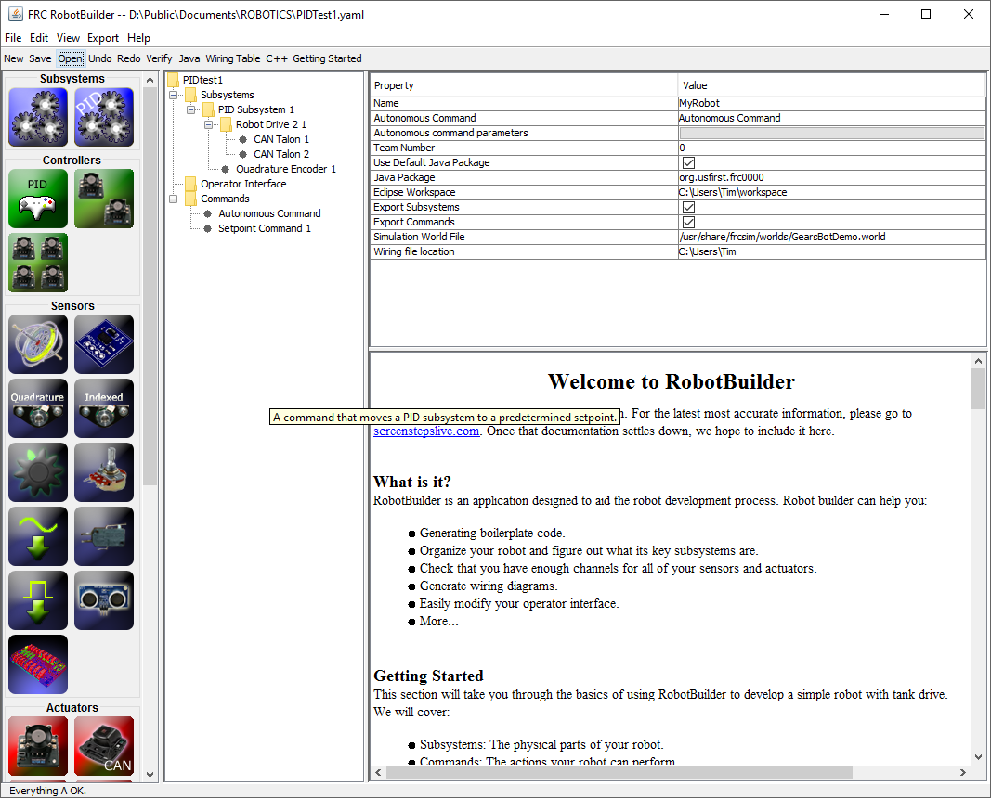
FRC RobotBuilder
Drag-n-drop icons to build
basic structure
Generates C++ and Java
In Command Based structure
Code Generators are a common
Get-em-up quick tool
But there are limitations
Class Names = Object Names
not always true
Cannot do more complex structures
Violates some concepts of
Encapsulation (especially in
Robotmap)
Got us going the last two seasons
Is it Time to move on?
Notes:
Really does create code that violates object oriented and encapsulation
The naming convention for some classes shows up all over, even where it’s obvious teams are not using this tool
Best Practices – there are syntactical requirements, standards, and then conventions. The first is enforced, the others get broken all the time. My examples do not follow conventions because I don’t do java at work!!!

Slide 9
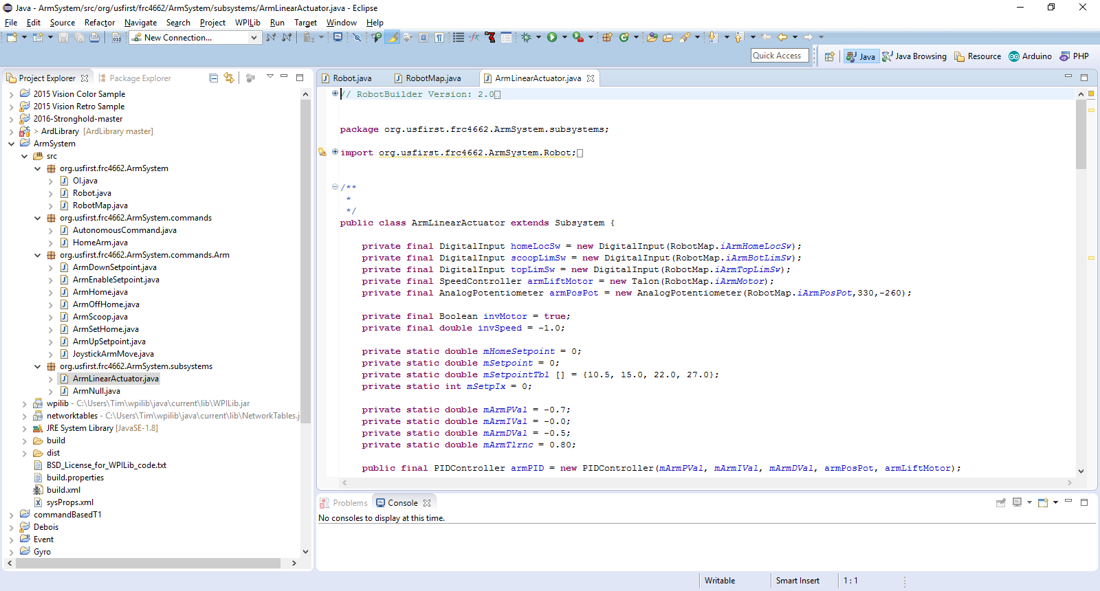
Eclipse IDE
Integrated Development Environment
Open Source eclipse.org
Add-ons for many languages
Real-time syntax and reference validation
WPIlib extensions for FRC authorized objects
3rd party support for optional add-ons
e.g. Original Equipment Manufacturers may provide Java/C++ code for their products as either samples or libraries
https://eclipse.org/home
Notes:
Don’t get hung up in the exact layout. Screen shots are from installs with additional tools.
There are some new wrinkles in this sample that we’ll get into when looking at the code
NOTE that the names shown at the detail level in this shot are class names, the physical files may actually contain multiple classes.
Be aware of the logical code structure, not just where each piece is stored.
Also note that the wpilib source is all available here and can be looked at. Some teams have programmers that have “enhanced” the wpi code.

Slide 10
Eclipse
ArmSystem
Notes:
Have eclipse open to the project.

Slide 11
EXERCISES
Arm System
Initialize (replace current autonomous)
Fix isOnTarget logic
Capture Setpoint Values into Table
Read Setpoint Table from File
Save Setpoint Table to File
How would you handle two linear actuators?

